Slide 1
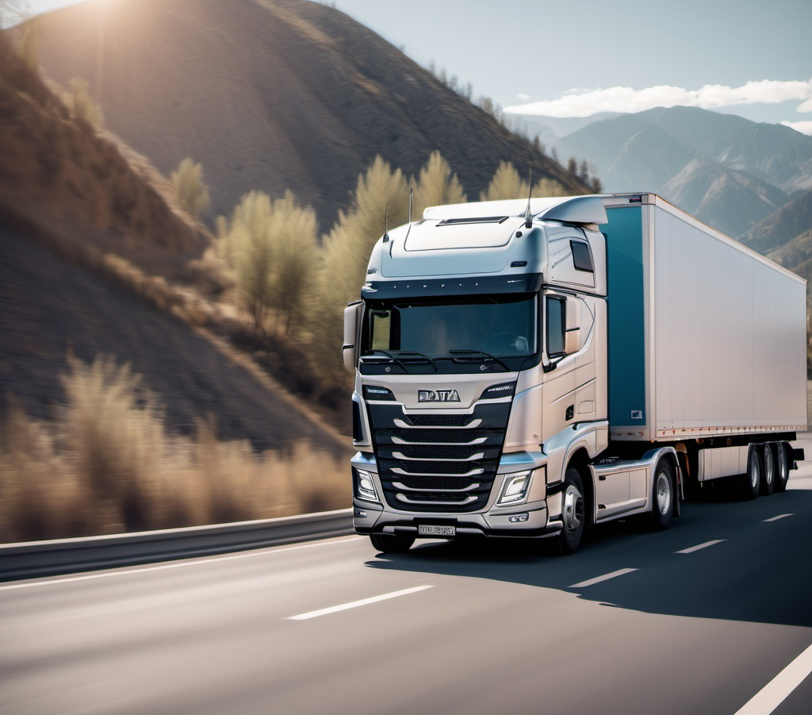





Big Data Analytics for Trucking Risk Assessment

Slide 2
About
About: Arizona National Trucking (ANT) is dedicated to upholding the highest safety and compliance standards in the trucking industry.
Problem: With a strong commitment to minimizing risk, ANT ensures its drivers adhere to all laws and regulations to prevent accidents and maintain operational excellence.
Actions:
Risk Analysis: Analyze driver risk factors using metrics such as events, distances traveled, average speeds, and mileage.
Risk Identification: Identify high-risk drivers based on geographic location, vehicle data, mileage, gas consumption, and events.
Risk Mitigation: Minimize driver risks to reduce accidents and improve safety in California's commercial trucking industry.

Slide 3
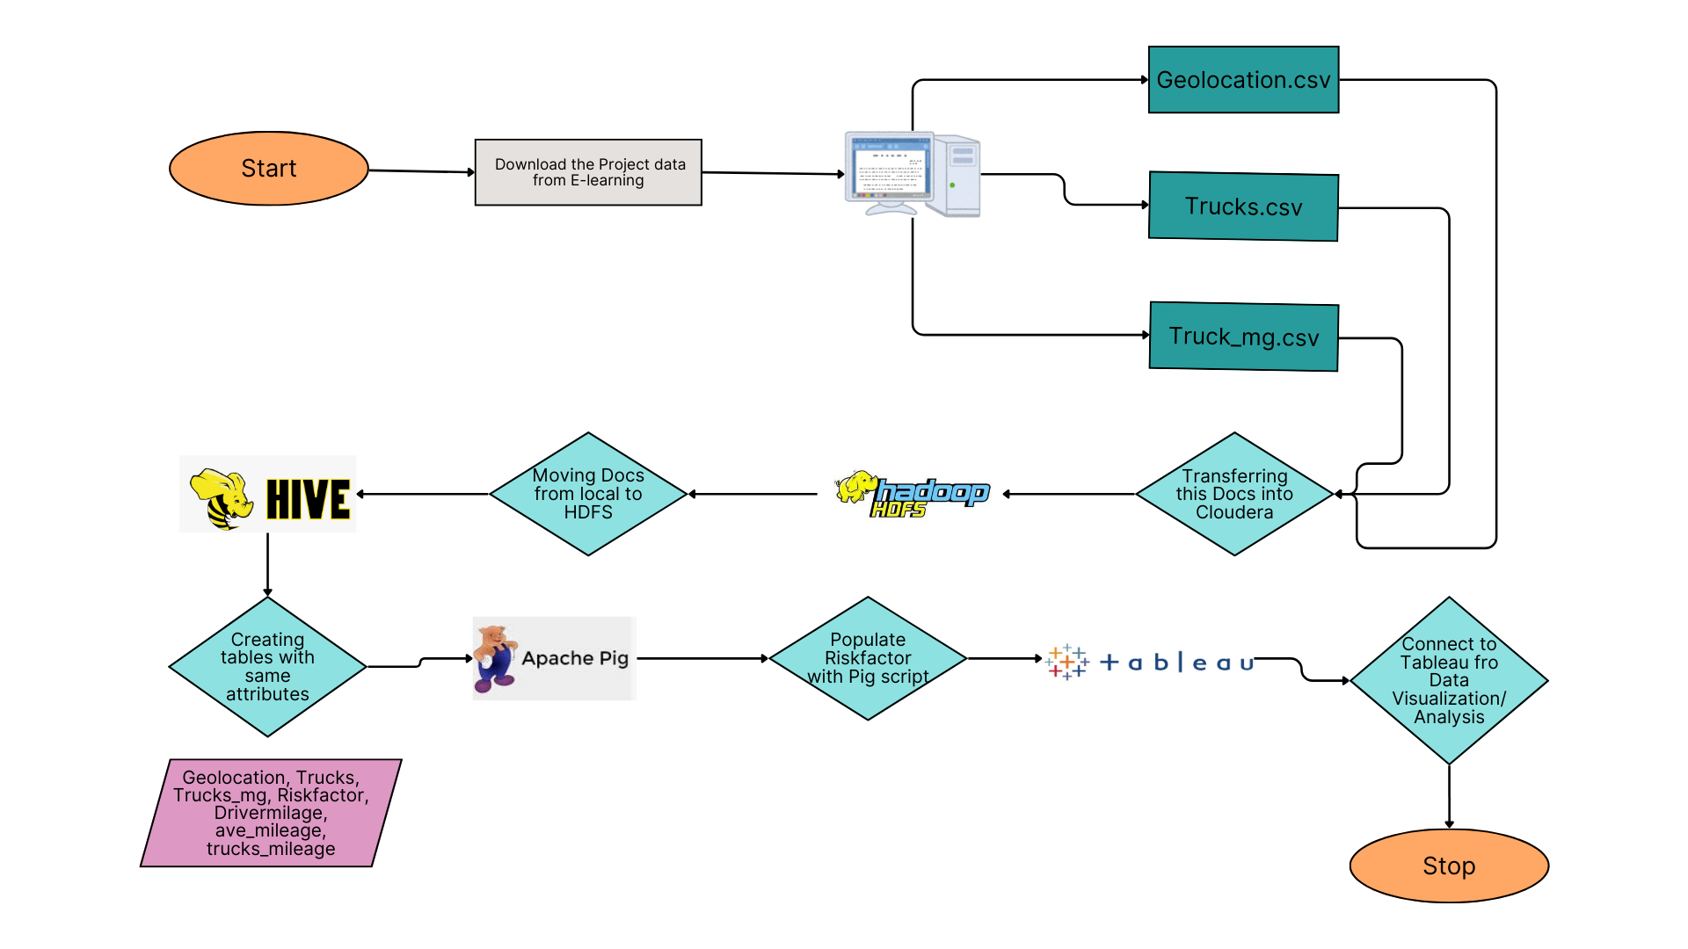
Data Processing

Slide 4
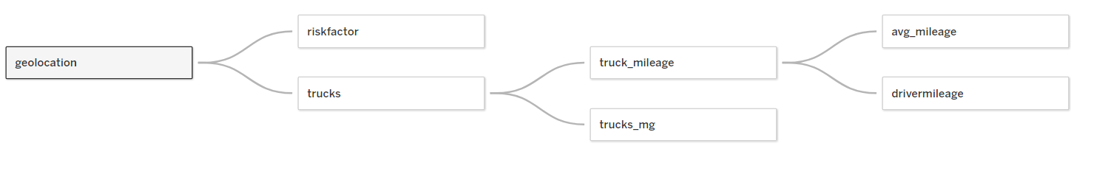

Data Modeling
Total # of Cities | 55
Total # of Drivers | 100
Total # of Truck Models | 100
Minimum Risk Factor | 1.50
Maximum Risk Factor | 31.69

Slide 5
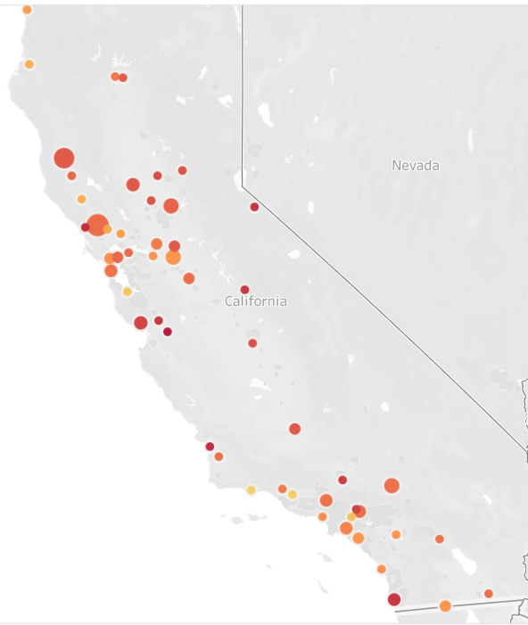
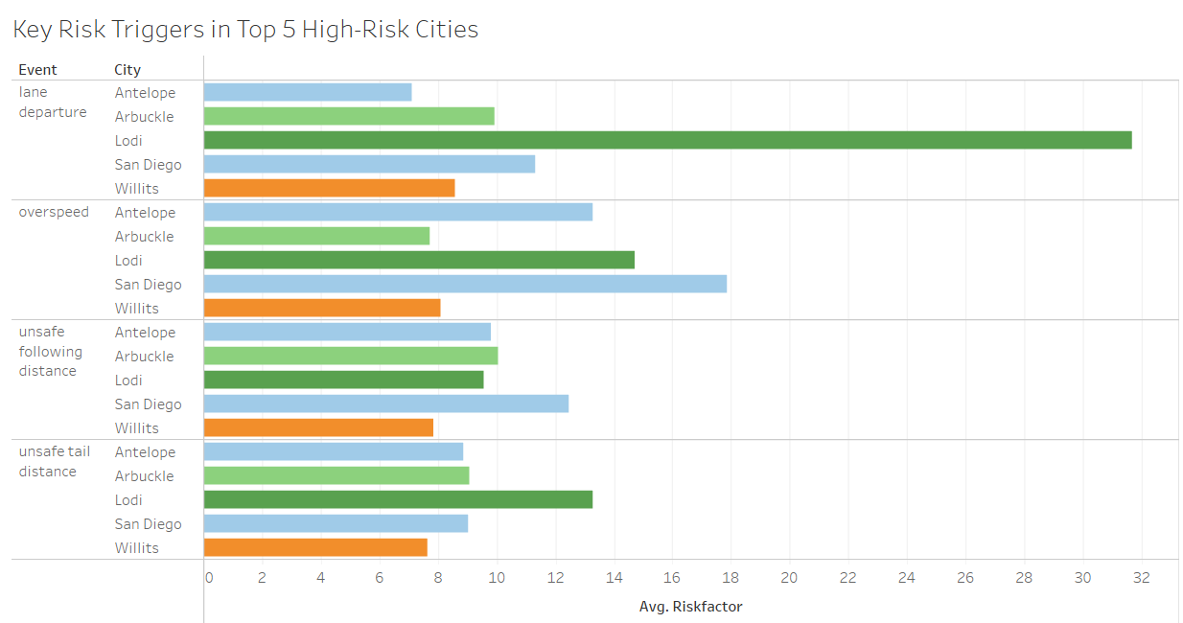
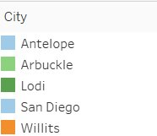

High-Risk Areas
Which areas pose the highest risk of driving?

Slide 6
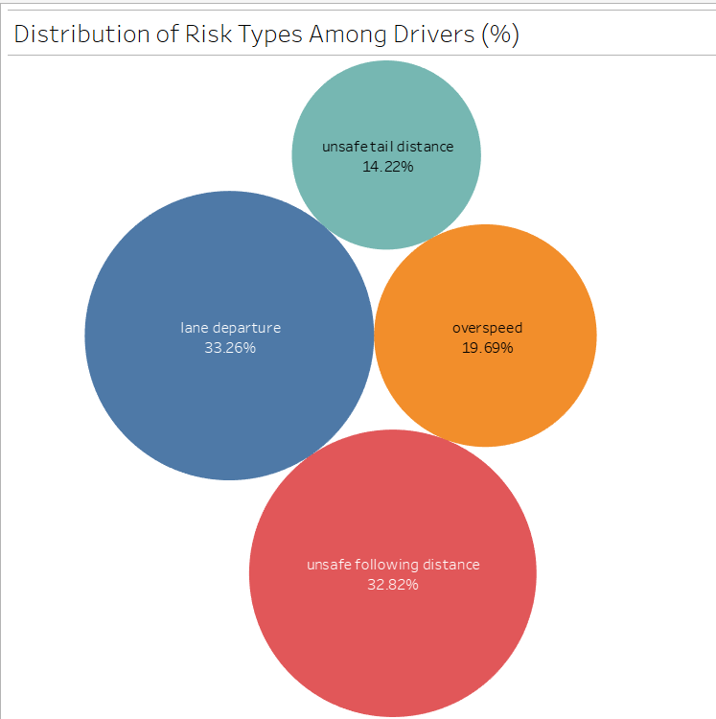
Which types of events are most prominent?
Lane Departure:
Implement lane departure warning systems (LDWS) and automatic lane-keeping assist in vehicles.
Increase awareness campaigns focused on the dangers of lane departure, emphasizing defensive driving techniques.
Unsafe Following Distance:
Encourage the adoption of adaptive cruise control systems to maintain safe distances automatically.
Conduct driver training programs emphasizing the "3-second rule" to maintain adequate following distance.

Slide 7
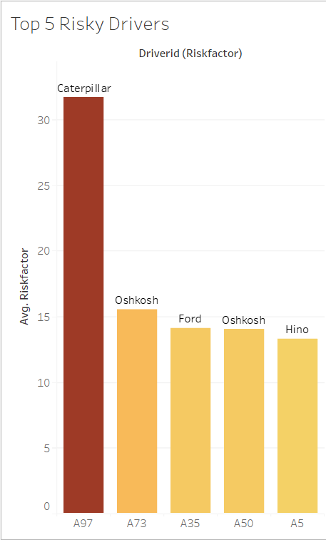
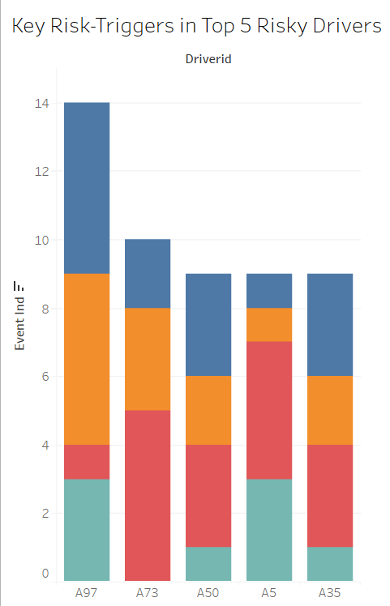
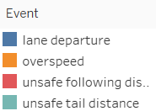

High-Risk Drivers
Who are the riskiest drivers and what events make them risky?

Slide 8
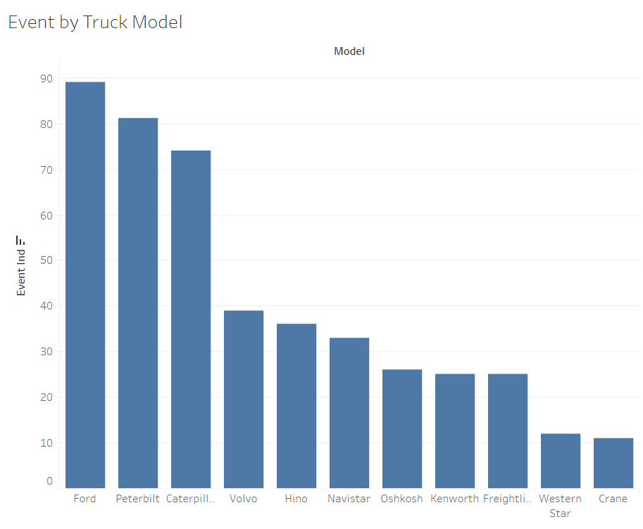
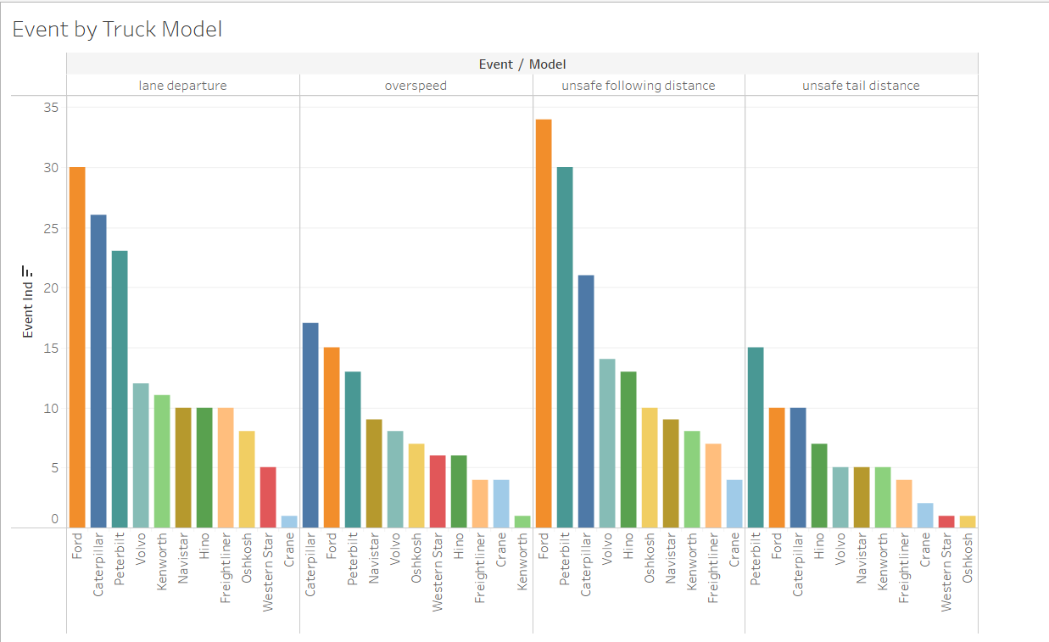
High-Risk Model
What models result in the most count of events?
Ford, Peterbilt, and Caterpillar are the models with high count of events.
Perform root cause analysis to identify specific risk factors associated with these models.
Compare accident rates across different models and manufacturing years for deeper insights.

Slide 9
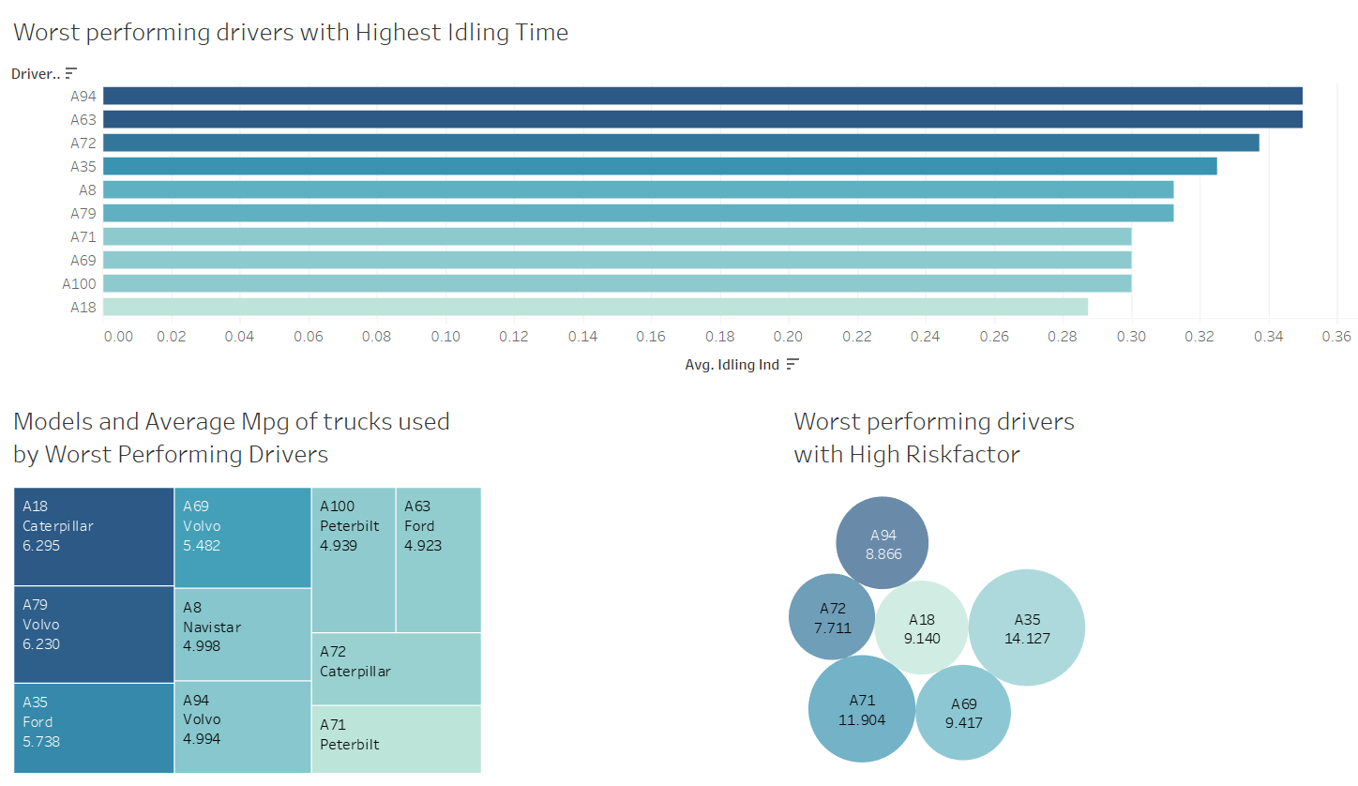
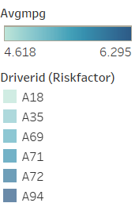

Slide 10

Recommendations
Driver A97 should have their license suspended and should be fired
Fleet managers should advise their drivers when they are entering a high-risk zone
Incentives for no events or improvements could be created
Monitor the speed of trucks throughout their routes

